Slide 1
Emurgo Academy Cardano Developer Professional Project
AImaGen NFT Minting and Vending Machine
Mint Unique AI Generated ART NFT by sending ADA
Manuel of Batch64 - Project Definition for
Emurgo Academy Cardano Developer Professional
Barcelona (Spain) January 2023

Slide 2
AImaGen NFT Minter and Vending Machine
Buyer have to send the exact amount of 28.556000 ADA to mint and receive the NFT.
Any other received amount will be sent back to the Buyer.

Slide 3

Running process:
Vending Machine waits for buyer payments, an enterprise type of address is used for operations: receives buyer payments, sends back wrong received amount, sends correct received amount to the contract address.
UTxOs queue is processed following the order of first to last received
payment.

Slide 4
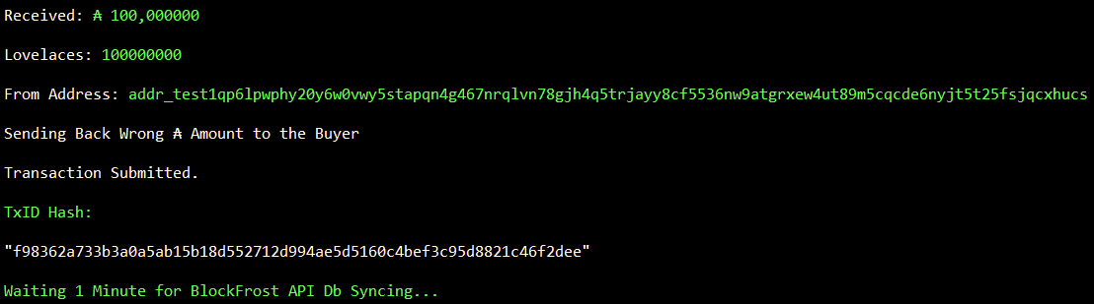
On wrong received amount, the operations address make a send back
Tx to the buyer. (Wrong received amount minus Tx fees).

Slide 5
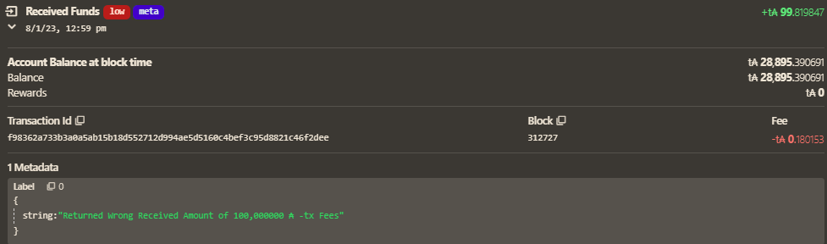
A Tx Metadata message is added to inform the buyer
about the refunding of wrong amount.

Slide 6
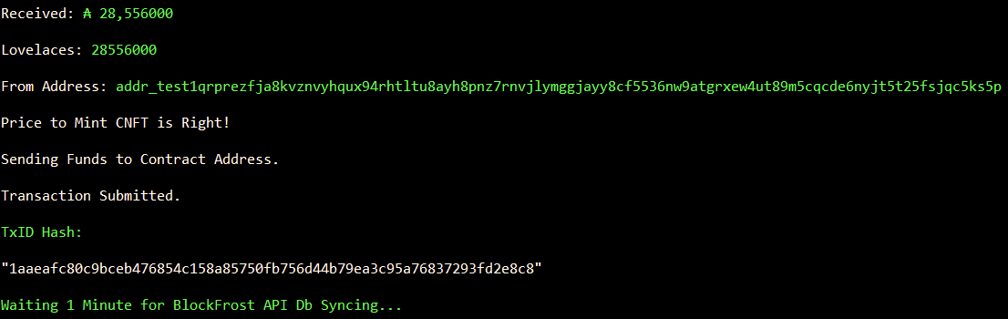
On right received amount, the operation address sends the funds
to contract script address.

Slide 7
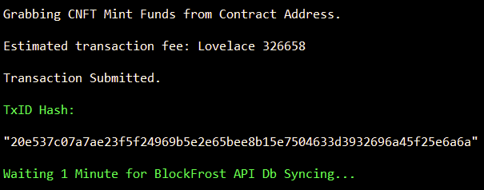
NFT minting address is the only authorized to spend the script.
Plutus validator uses Int for datum and redeemer (the NFT price)
and its paymentPubKeyHash.

Slide 8
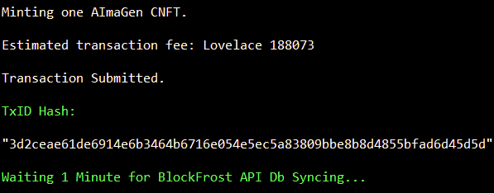
NFT Construction and Minting process starts.
An Image is created by passing to Stable Diffusion AI a sentence generated by Python library “essential generators”.
Image is then pinned to IPFS using Infura.
NFT name is AImaGen@<unix timestamp>.

Slide 9
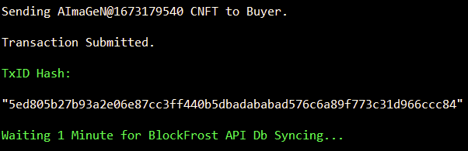
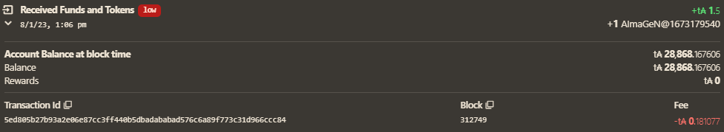
Minted NFT is sent to the buyer through the same minting address.

Slide 10
